Slide 1


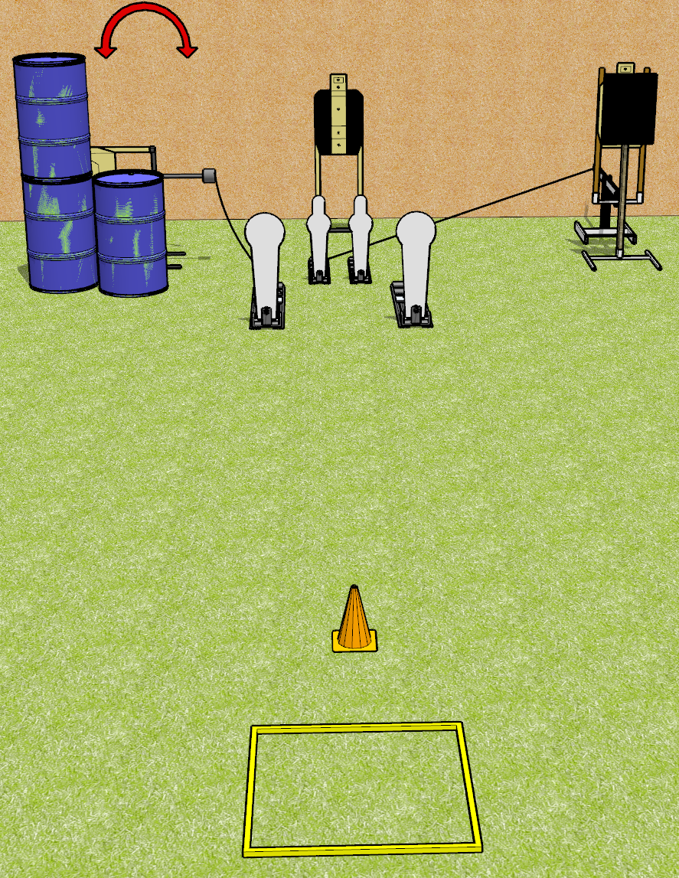
 | Dothan Gun Club – USPSA Match Now That’s Spicy Course Designer : Drew Coleman
Round Count 13 rounds 3 USPSA targets 2 colt poppers, 2 mini poppers
Equipment List Shooting box Swinger + activator Bobber + activator + steel 18x24 plate and stand 1 tuxedo

Slide 2
Now That’s Spicy
Written Stage Briefing
Now That’s Spicy is a 13 round, 65 point, Comstock speed shoot. There are 3 USPSA targets, 2 colt poppers, and 2 mini poppers. The best 3 hits on paper will score, and steel must fall to score. The start signal is audible.
The bobber is activated by either mini popper. The swinger is activated by the left colt popper. Please check the activators prior to walkthrough and set them the same way every time.
Handgun start position is in the shooting box, wrists below belt. Handgun is loaded and holstered.
PCC start position is in the shooting box, muzzle pointed at cone. Loaded carbine is held with both hands, safety on.
On start signal, engage any 2 poppers, perform a mandatory reload, and engage the remaining poppers. The paper targets may be engaged at any time in any order. Engaging more than 2 poppers without reloading will be a single procedural per popper engaged.

Slide 3
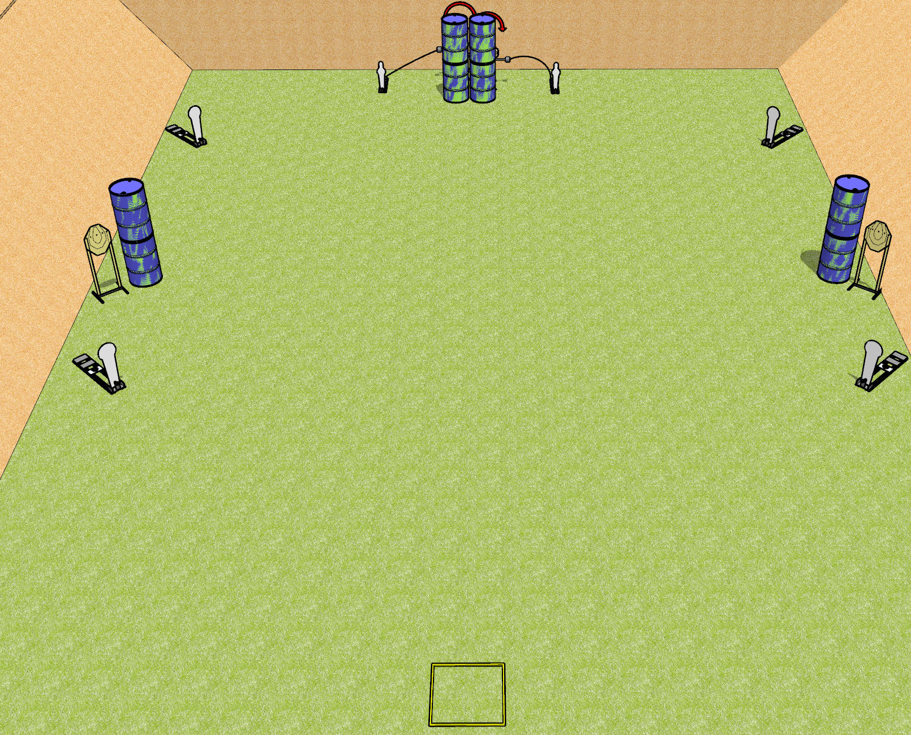
 | Dothan Gun Club – USPSA Match Quickness Course Designer : Drew Coleman
Round Count 14 rounds 4 IPSC targets 4 colt poppers, 2 USPSA mini poppers
Equipment List 2 swingers + activators Shooting box Barrels near the static paper are spall protection – look at setup and use if needed

Slide 4
Quickness
Written Stage Briefing
Quickness is a 14 round, 70 point, Comstock speed shoot. There are 4 IPSC targets, 4 colt poppers, and 2 USPSA mini poppers. The best 2 hits on paper will score, and steel must fall to score. The start signal is audible.
The left swinger is activated by the left mini popper, and the right swinger is activated by the right mini popper. Please check the activators prior to walkthrough and set them the same way every time.
Handgun start position is in shooting box facing uprange, wrists above shoulders. Handgun is loaded and holstered.
PCC start position is in shooting box. Loaded carbine is held with both hands, stock on belt, safety on.
On start signal, engage the left poppers and static paper OR the right poppers and static paper, then perform a mandatory reload and engage the remaining array. The swingers may be engaged at any time. Failure to perform a mandatory reload will incur a procedural penalty per shot fired until the reload is completed.

Slide 5
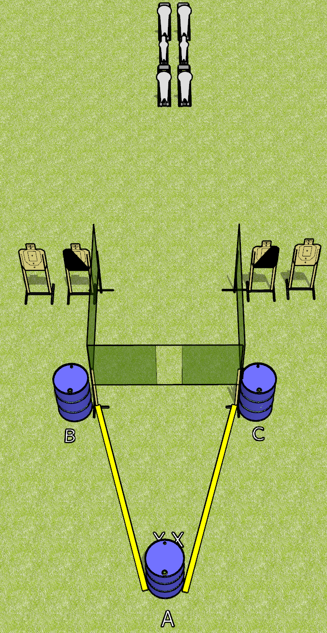
 | Dothan Gun Club – USPSA Match Borrowed from Jake Course Designer : Jake Martens
Round Count 14 rounds 4 USPSA targets 4 colt poppers, 2 mini poppers
Equipment List 4 wall feet

Slide 6
Borrowed from Jake
Written Stage Briefing
Borrowed from Jake is a 14 round, 70 point, Comstock medium course. There are 4 USPSA targets, 4 colt poppers, and 2 mini poppers. The best 2 hits on paper will score, and steel must fall to score. The start signal is audible.
Start position is toes touching X’s, facing uprange, both hands touching top surface of barrel A. Firearm is placed on barrel B OR barrel C, unloaded and unpropped. All magazines to be used on the stage must be placed on a barrel WITHOUT the firearm, including barrel A.
On start signal, engage targets as they become available from within the fault lines.

Slide 7
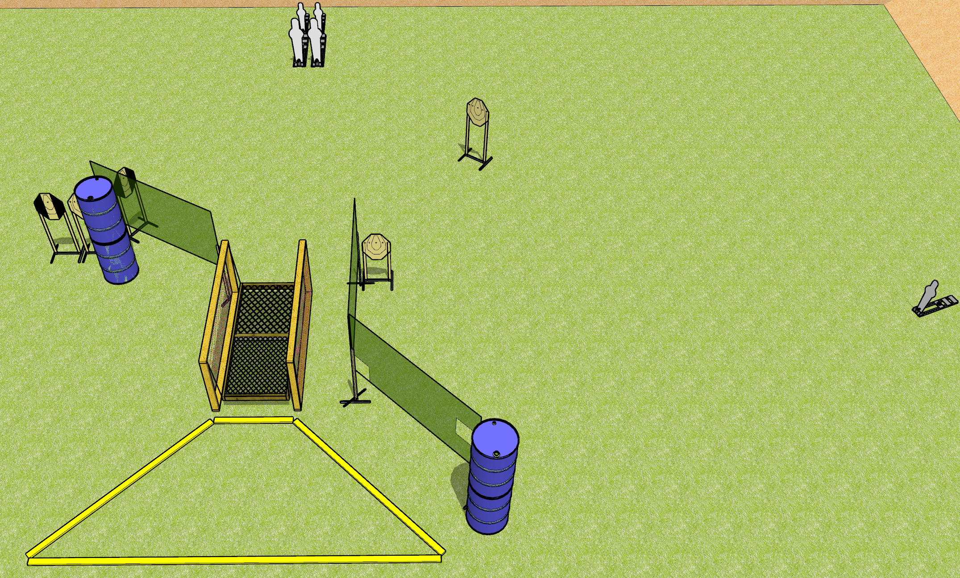
 | Dothan Gun Club – USPSA Match Wobbly Knees Course Designer : Drew Coleman
Round Count 15 rounds 5 IPSC 2 pepper poppers, 2 mini poppers
Equipment List Bridge 6 wall feet 1 medium fault line. 2 tuxedos

Slide 8
Wobbly Knees
Written Stage Briefing
Wobbly Knees is a 15 round, 65 point, Comstock course of fire. There are 5 IPSC targets, 2 pepper poppers, and 3 mini poppers. The best 2 hits on paper will score, and steel must fall to score. The start signal is audible.
The railing on the bridge is NOT part of the shooting area and cannot be used for support while firing. The platform itself is part of the shooting area.
Handgun start position is one foot inside, one foot outside of the shooting area, wrists below belt. Handgun is loaded and holstered.
PCC start position is one foot inside, one foot outside of the shooting area. Loaded carbine is held with both hands, stock on belt, safety on.
On start signal, engage targets as they become available from within the shooting area.

Slide 9
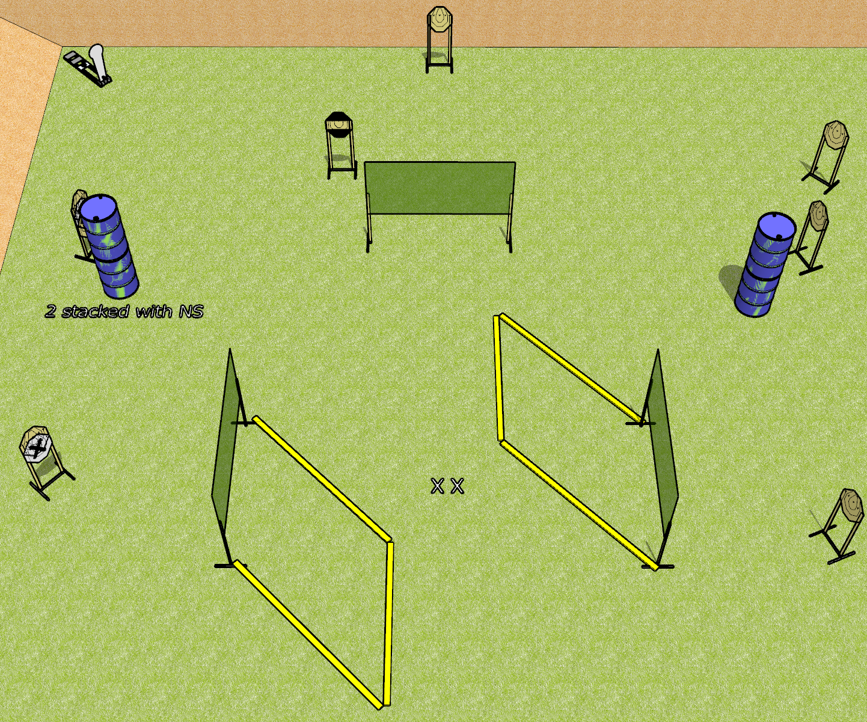
 | Dothan Gun Club – USPSA Match A Stage Has No Name Course Designer : Drew Coleman
Round Count 17 rounds 8 IPSC targets 1 colt popper
Equipment List 6 wall feet 1 stripe HC NOTE: use 2 10’ fault lines to extend away from the walls, and an 8’ to connect

Slide 10
A Stage Has No Name
Written Stage Briefing
A Stage Has No Name is a 17 round, 85 point, Comstock course of fire. There are 8 IPSC targets and 1 colt popper. The best 2 hits on paper will score, and steel must fall to score. The start signal is audible.
Handgun start position is both feet on X’s, wrists below belt. Handgun is loaded and holstered.
PCC start position is both feet on X’s. Loaded carbine is held with both hands, stock on belt, safety on.
On start signal, engage targets as they become available from within the shooting area.

Slide 11
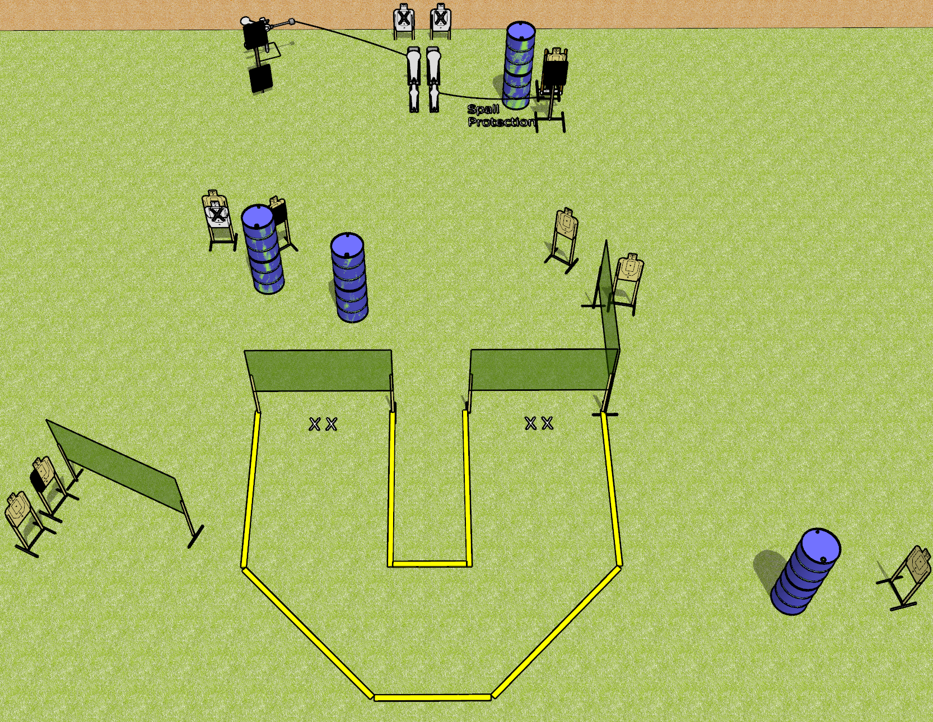
 | Dothan Gun Club – USPSA Match Footwork Course Designer : Drew Coleman
Round Count 22 rounds 9 USPSA targets 2 colt poppers, 2 mini poppers, 2 falling plates
Equipment List 7 wall feet 3 18x24 plates + stands 1 bobber Red stitch swinger 2 medium fault lines 1 50%, 1 left HC

Slide 12
Footwork
Written Stage Briefing
Footwork is a 22 round, 110 point, Comstock course of fire. There are 9 USPSA targets, 2 colt poppers, 2 mini poppers, and 2 falling plates. The best 2 hits on paper will score, and steel must fall to score. The start signal is audible.
The swinging steel target is activated by the left colt popper. The bobber is activated by the right mini popper. Please check the activators prior to walkthrough and set them the same way every time.
Handgun start position is both feet on either set of X’s, wrists below belt. Handgun is loaded and holstered.
PCC start position is both feet on either set of X’s. Loaded carbine is held with both hands, stock on belt, safety on.
On start signal, engage targets from within the shooting area.

Slide 13
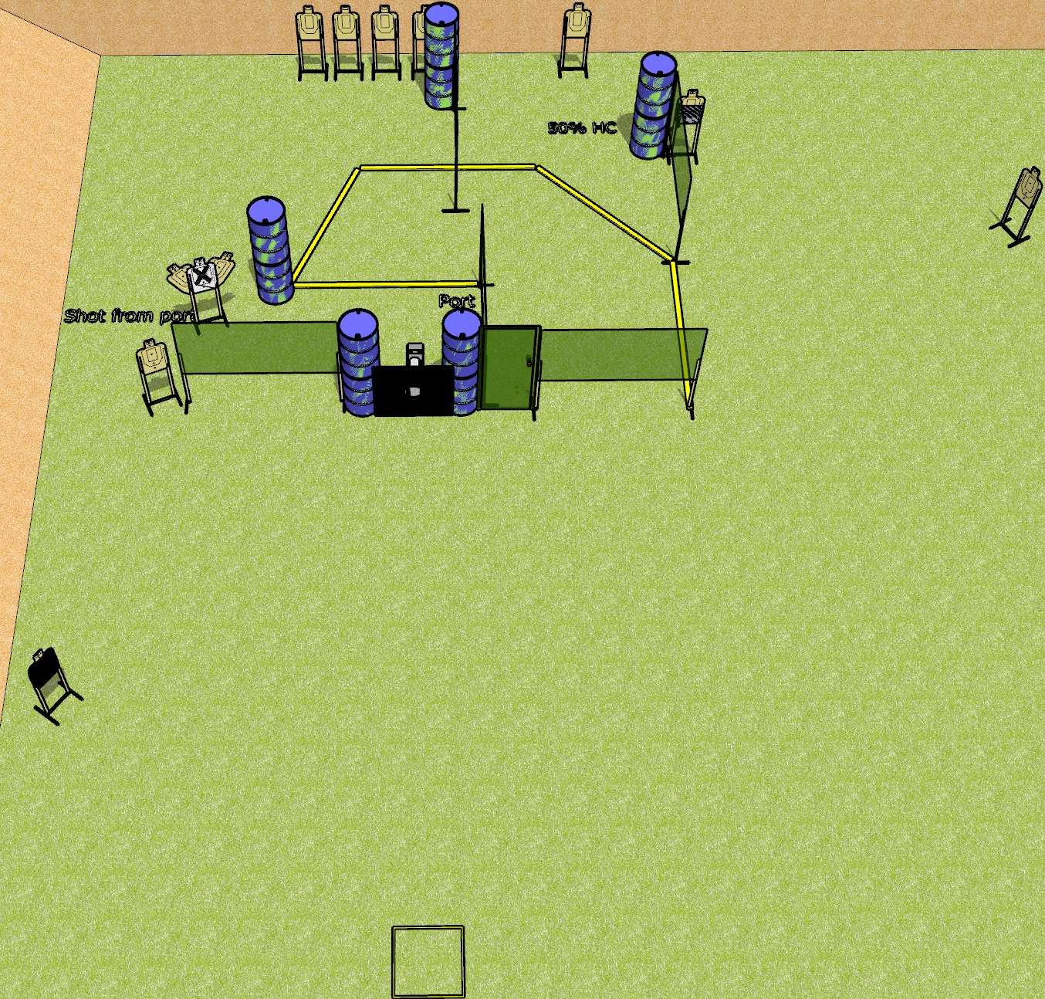
 | Dothan Gun Club – USPSA Match Door Kicker Course Designer : Drew Coleman
Round Count 23 rounds 12 USPSA targets 1 pepper popper
Equipment List 10 wall feet Big plate with hole in it + 2 stands Door 2 50%, 1 headshot NOTE: targets with NS on the left should be angled to port

Slide 14
Door Kicker
Written Stage Briefing
Door Kicker is a 23 round, 115 point, Comstock course of fire. There are 12 USPSA targets and 1 pepper popper. The best 2 hits on paper will score, and steel must fall to score. The start signal is audible.
The door is “locked” with an activator that is activated by the pepper popper. Please check the activator prior to walkthrough and set it the same way every time.
Handgun start position is in start box, wrists below belt. Handgun is loaded and holstered.
PCC start position is in start box. Loaded carbine is held with both hands, stock on belt, safety on.
On start signal engage targets as they become available from within the shooting area.

Slide 15
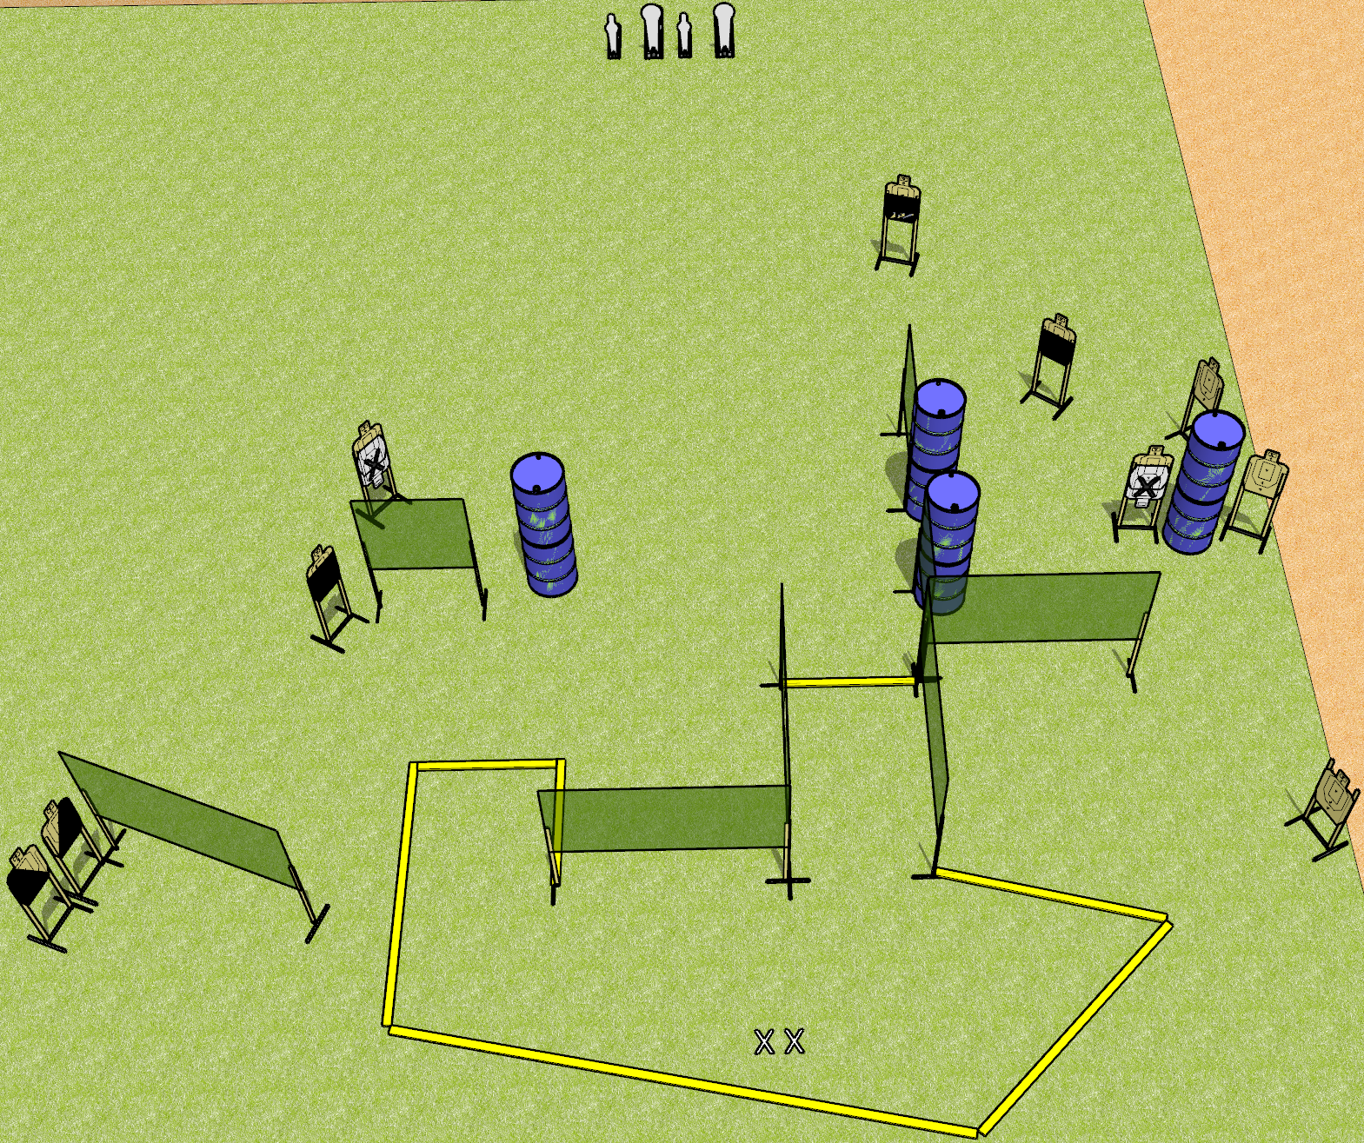
 | Dothan Gun Club – USPSA Match Well Technically Course Designer : Drew Coleman
Round Count 24 rounds 10 USPSA targets 2 colt poppers, 2 mini poppers
Equipment List 13 wall feet 1 action target, 2 50%, 1 left and 1 right diagonal

Slide 16
Well Technically
Written Stage Briefing
Well Technically is a 24 round, 120 point, Comstock field course. There are 10 USPSA targets, 2 colt poppers, and 2 mini poppers. The best 2 hits on paper will score, and steel must fall to score. The start signal is audible.
Handgun start position is both feet on X’s, wrists above shoulders. Handgun is loaded and holstered.
PCC start position is both feet on X’s. Loaded carbine is held with both hands, stock on belt, safety on.
On start signal, engage targets as they become available from within the shooting area.

Slide 17
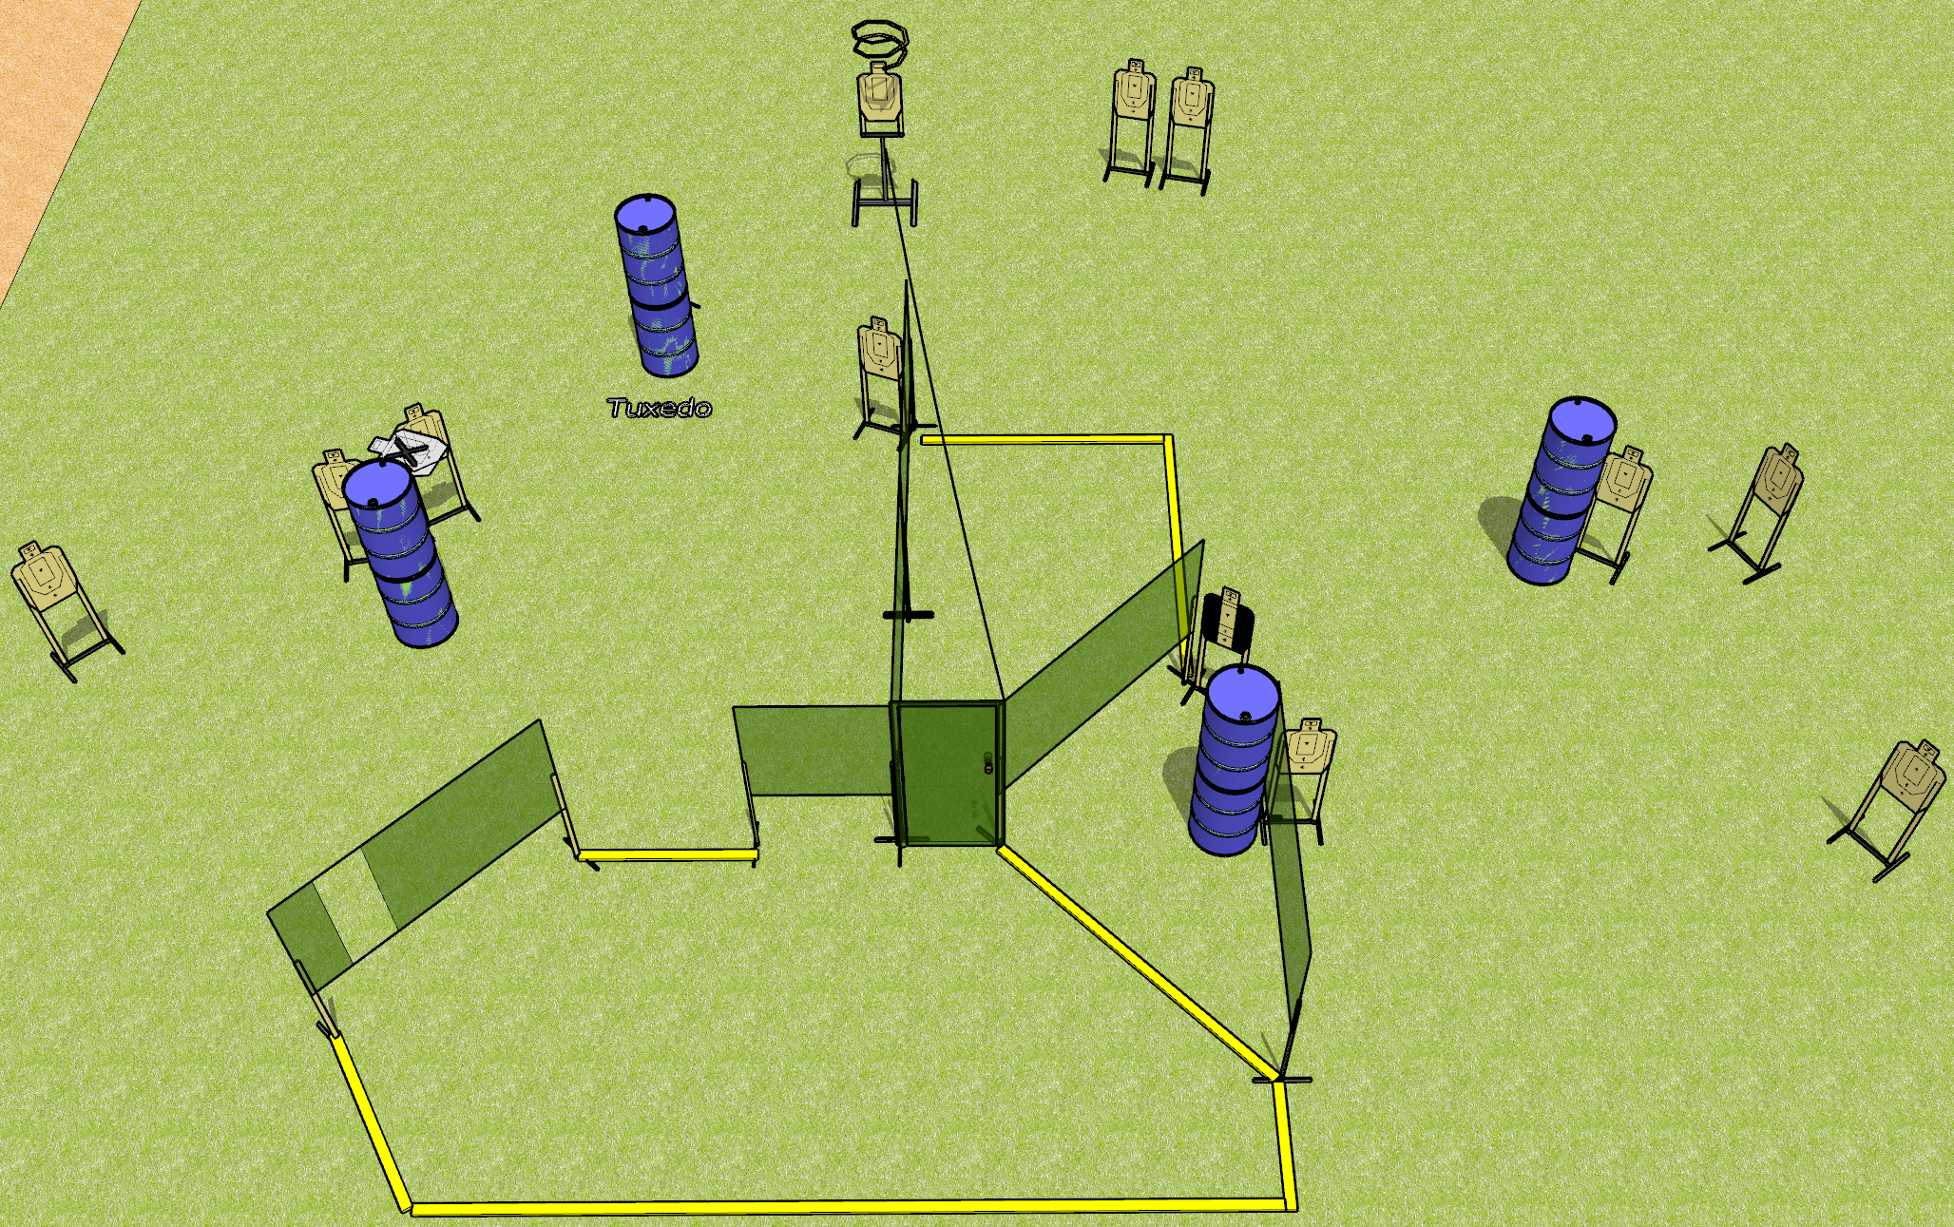
 | Dothan Gun Club – USPSA Match Knock Knock Course Designer : Drew Coleman
Round Count 26 rounds 13 USPSA targets
Equipment List 10 wall feet Door Drop turner 2 tuxedos

Slide 18
Knock Knock
Written Stage Briefing
Knock Knock is a 26 round, 130 point, Comstock field course. There are 13 USPSA targets. The best 2 hits on paper will score. The start signal is audible.
The drop turner is activated by opening the door and is a disappearing target. Please check the activator prior to walkthrough and set it the same way every time.
Handgun start position is both hands touching door. Handgun is unloaded and holstered.
PCC start position is muzzle touching door, unloaded.
On start signal, engage targets from within the shooting area.

Slide 19
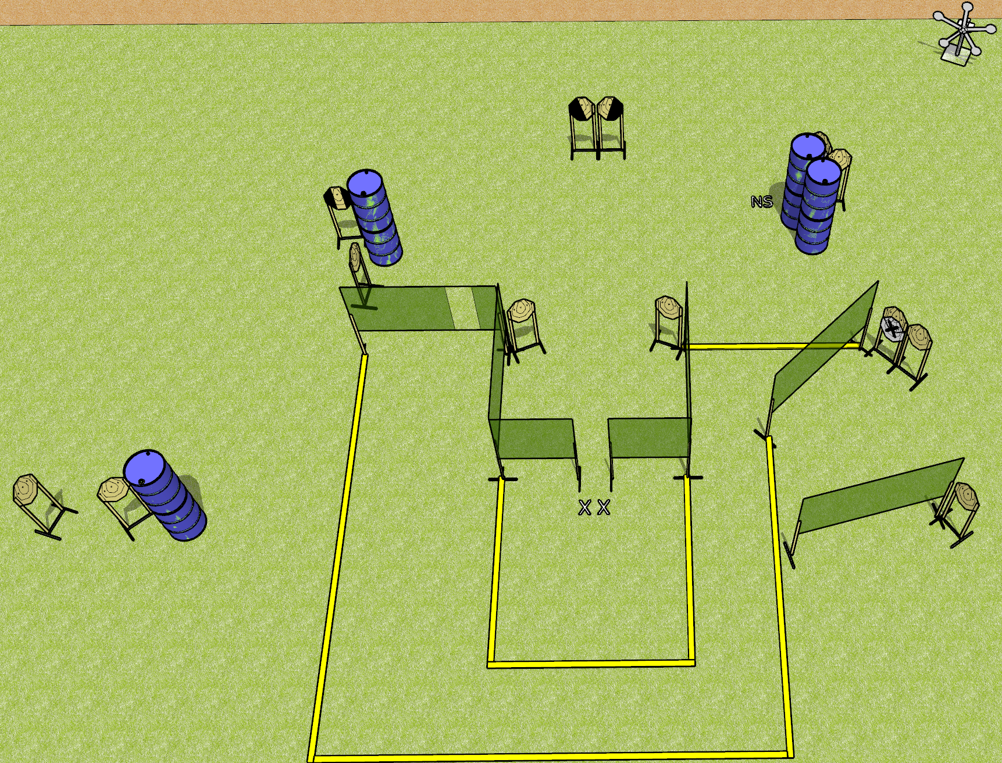
 | Dothan Gun Club – USPSA Match You Can’t Make This Up Course Designer : Drew Coleman
Round Count 29 rounds 12 IPSC targets 5 falling plates
Equipment List 11 wall feet Texas star 1 tux, 1 left and 1 right diagonal NOTE: target behind barrels on the right has a NS on it

Slide 20
You Can’t Make This Up
Written Stage Briefing
You Can’t Make This Up is a 29 round, 145 point, Comstock field course. There are 12 IPSC targets and 5 falling plates. The best 2 hits on paper will score and steel must fall to score. The start signal is audible.
Handgun start position is both feet on X’s, hands touching both walls. Handgun is loaded and holstered.
PCC start position is both feet on X’s, muzzle touching either wall. Carbine is loaded, safety on.
On start signal, engage targets as they become available from within the shooting area.

Slide 21
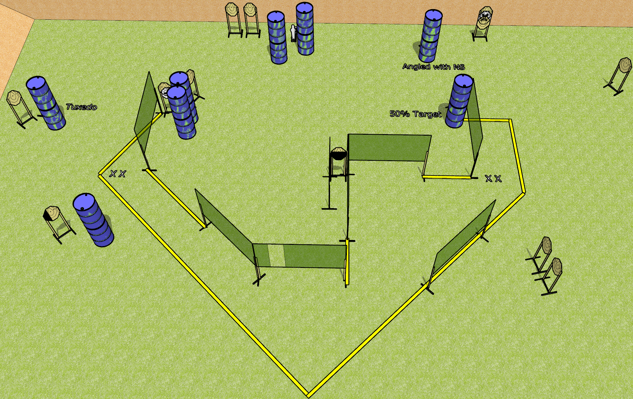
 | Dothan Gun Club – USPSA Match Flights of Fancy Course Designer : Drew Coleman
Round Count 31 15 ISPC 1 Mini popper
Equipment List 3 medium fault lines 15 wall feet

Slide 22
Flights of Fancy
Written Stage Briefing
Flights of Fancy is a 31 round, 155 point, Comstock field course. There are 15 IPSC targets and 1 mini popper. The best 2 hits on paper will score, and steel must fall to score. The start signal is audible.
Handgun start position is both feet on either set of X’s, wrists below belt. Handgun is loaded and holstered.
PCC start position is both feet on either set of X’s. Loaded carbine is held with both hands, stock on belt, safety on.
On start signal, engage targets as they become available from within the shooting area.

Slide 23
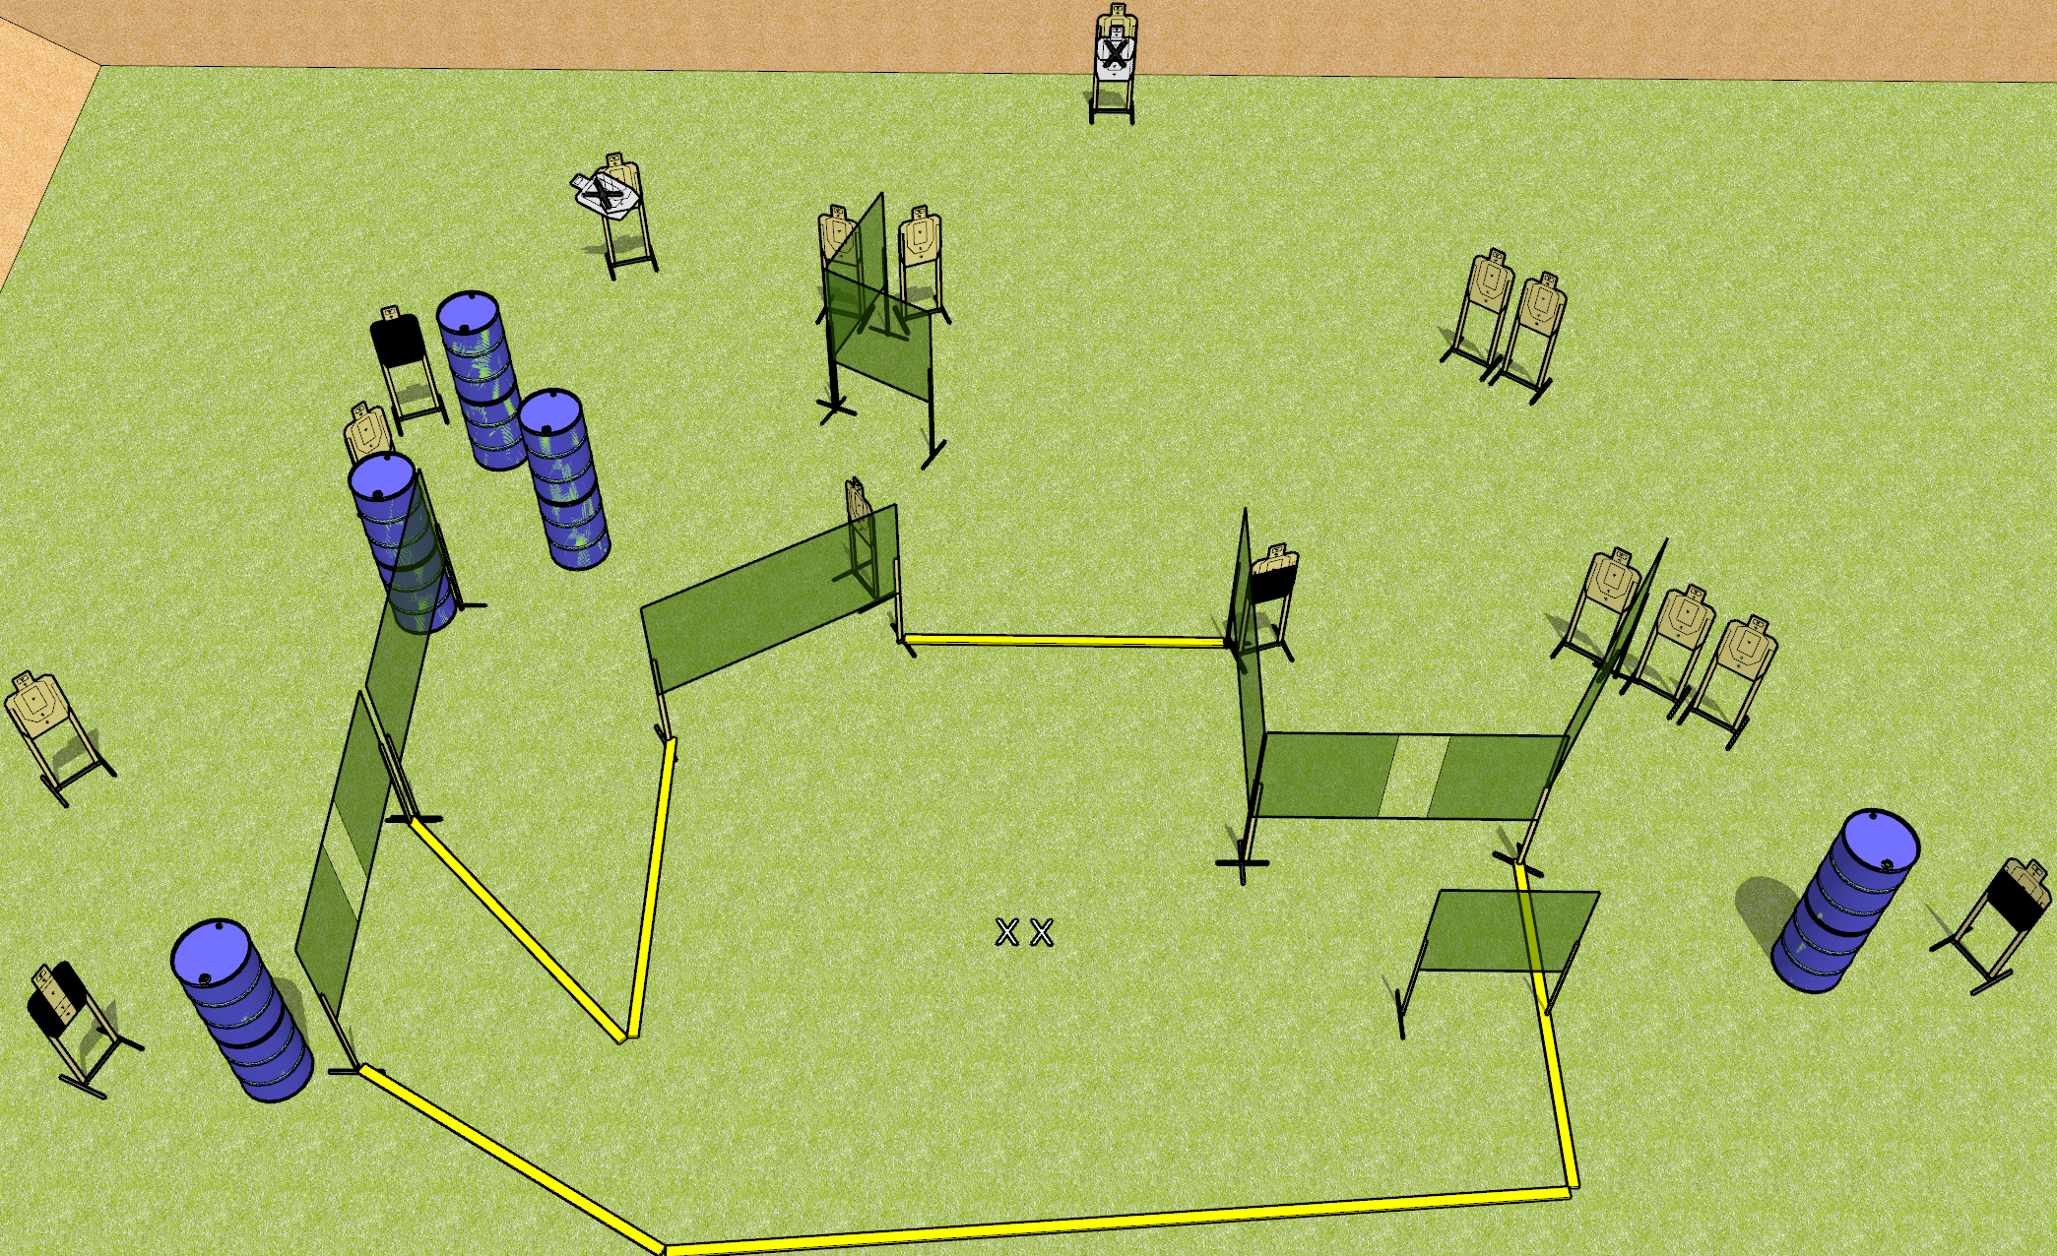
 | Dothan Gun Club – USPSA Match Sweet Dreams Course Designer : Drew Coleman
32 rounds 16 USPSA targets
Equipment List 15 wall feet 1 tuxedo, 2 50% OR action target, 1 headshot

Slide 24
Sweet Dreams
Written Stage Briefing
Sweet Dreams is a 32 round, 160 point, Comstock field course. There are 16 USPSA targets. The best 2 hits on paper will score, and steel must fall to score. The start signal is audible.
Handgun start position is both feet on X’s, wrists below belt. Handgun is loaded and holstered.
PCC start position is both feet on X’s. Loaded carbine is held with both hands, stock on belt, safety on.
On start signal, engage targets as they become available from within the shooting area.

Slide 25
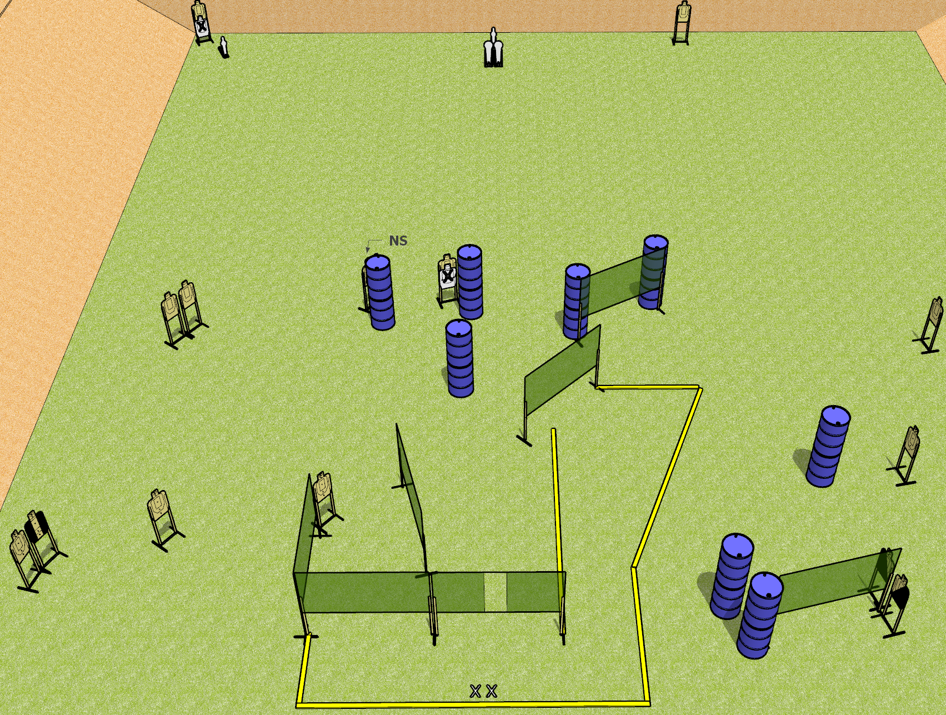
 | Dothan Gun Club – USPSA Match Mom’s Spaghetti Course Designer : Drew Coleman
Round Count 32 rounds 14 USPSA targets 2 colt poppers, 2 USPSA mini poppers
Equipment List 12 wall feet 2 Tuxedos, 1 left diagonal, 1 right diagonal

Slide 26
Mom’s Spaghetti
Written Stage Briefing
Mom’s Spaghetti is a 32 round, 160 point, Comstock field course. There are 14 USPSA targets, 2 colt poppers, and 2 USPSA mini poppers. The best 2 hits on paper will score, and steel must fall to score. The start signal is audible.
Handgun start position is both feet on X’s, wrists below belt. Handgun is loaded and holstered.
PCC start position is both feet on X’s. Loaded carbine is held with both hands, stock on belt, safety on.
On start signal, engage targets as they become available from within the shooting area.

Slide 27
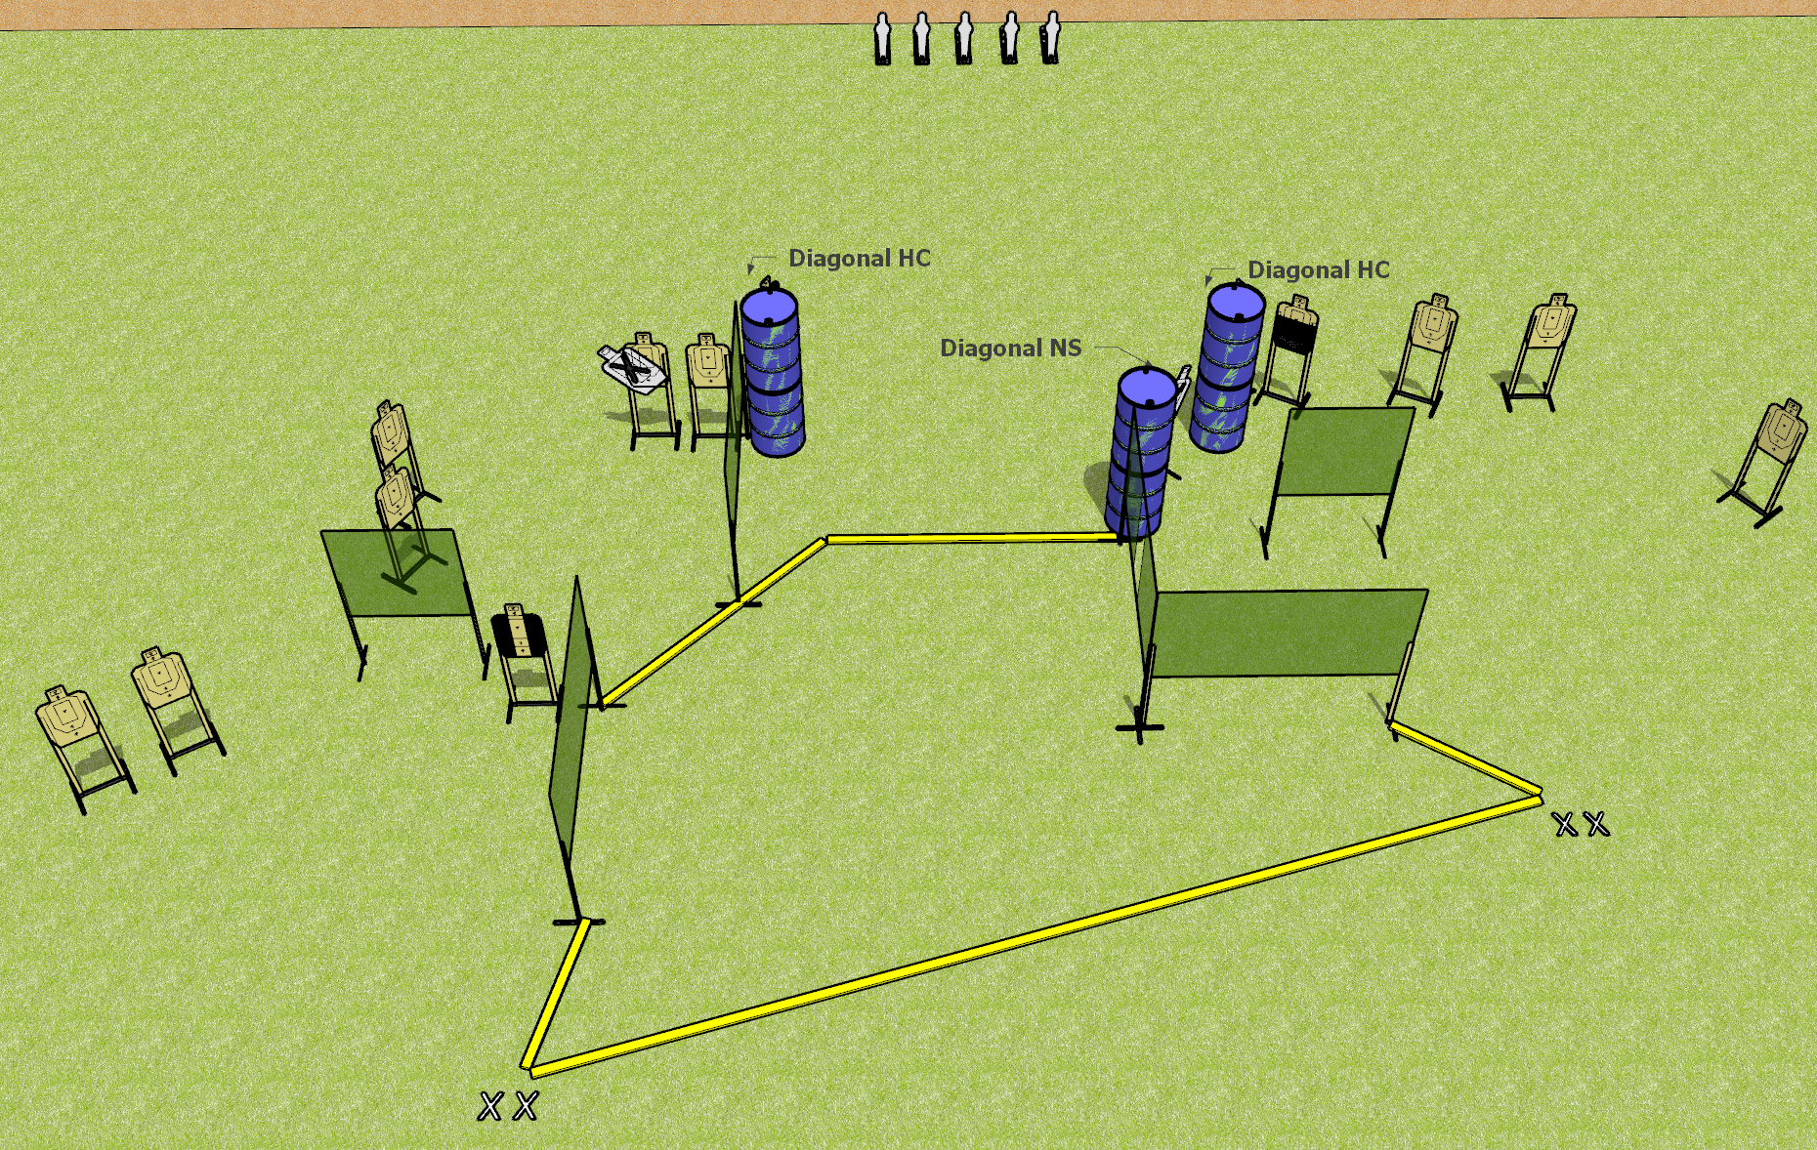
 | Dothan Gun Club – USPSA Match Fun in the Sun Course Designer : Drew Coleman
Round Count 33 rounds 14 USPSA targets 5 USPSA mini poppers
Equipment List 11 wall feet 1 tuxedo, 1 left diagonal and 1 right diagonal, 1 50%

Slide 28
Fun in the Sun
Written Stage Briefing
Fun in the Sun is a 33 round, 165 point, Comstock field course. There are 14 USPSA targets and 5 USPSA mini poppers. The best 2 hits on paper will score, and steel must fall to score. The start signal is audible.
Handgun start position is both feet on either set of X’s, wrists below belt. Handgun is loaded and holstered.
PCC start position is both feet on either set of X’s. Loaded carbine is held with both hands, stock on belt, safety on.
On start signal, engage targets as they become available from within the shooting area.

Slide 29
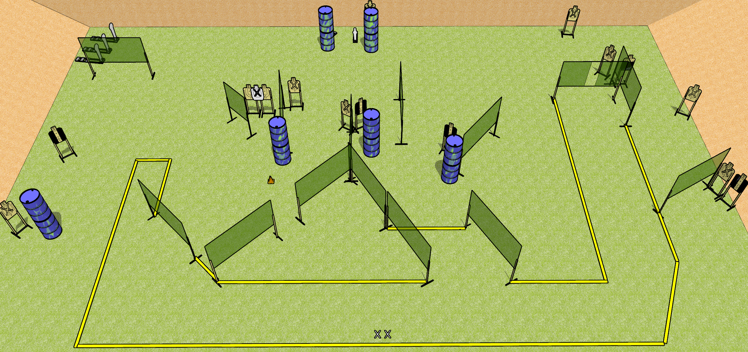
 | Dothan Gun Club – USPSA Match Bring Your A-Game Course Designer : Drew Coleman
Round Count 35 rounds 15 USPSA targets 3 colt poppers, 2 USPSA mini poppers
Equipment List 26 wall feet Setup Note: there’s a mini behind the left set of barrels by the berm, and a paper target behind the other set to the right.

Slide 30
Bring Your A-Game
Written Stage Briefing
Bring Your A-Game is a 35 round, 175 point, Comstock field course. There are 15 USPSA targets, 3 colt poppers, and 2 USPSA mini poppers. The best two hits on paper will score, and steel must fall to score.
Handgun start position is both feet on X’s, wrists below belt. Handgun is loaded and holstered.
PCC start position is both feet on X’s. Loaded carbine is held with both hands, stock on belt, safety on.
On start signal, engage targets as they become available from within the shooting area.

